Slide 1

Testing method for recovering rare program bugs
SE Dept.
Students: Naor Ben David
Kfir Bublil
Supervisor: Dr. Renata Avros
Counselor: Prof. Zeev Volkovich
Date: 02.02.15

Slide 2
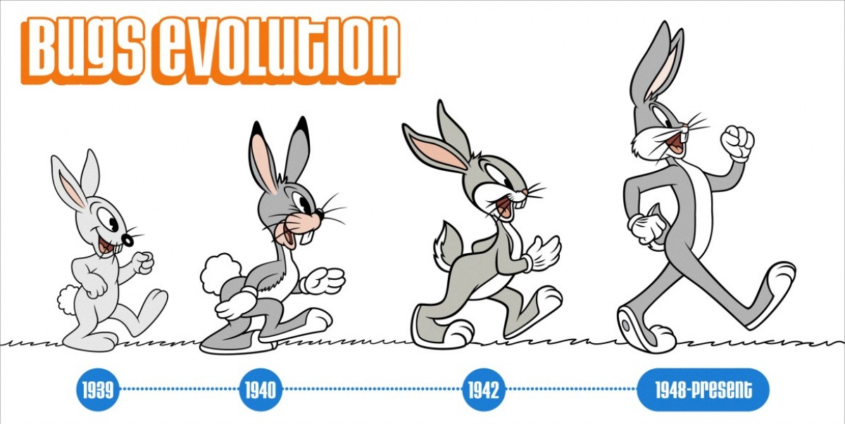

Concise description
The main objective of the project is an implementation of a statistical analysis procedure, in order to testing and recovering rare program bugs.

Slide 3
Motivation
Our aim is to give an ability to computers to testing software projects more intelligent.
Main difficulties:
Give an ability for machine to think.
More than that, make machine thinking logically.

Slide 4
AdaBoost - Adaptive Boosting
AdaBoost, short for Adaptive Boosting, is a machine learning algorithm, formulated by Yoav Freund and Robert Schapire.
It is an algorithm which can be used in conjunction with many other learning algorithms to improve their performance.
AdaBoost is adaptive in the sense that subsequent classifiers built are tweaked in favour of those instances misclassified by previous classifiers.
AdaBoost is sensitive to noisy data and outliers.
Usually AdaBoost uses for image processing.

Slide 5
AdaBoost
Boosting is based on the question posed by Kearns:
can a set of weak learners create a single strong learner?
A weak learner is defined to be a classifier which is only slightly correlated with the true classification (it can label examples better than random guessing)
A strong learner is a classifier that is arbitrarily well correlated with the true classification

Slide 6
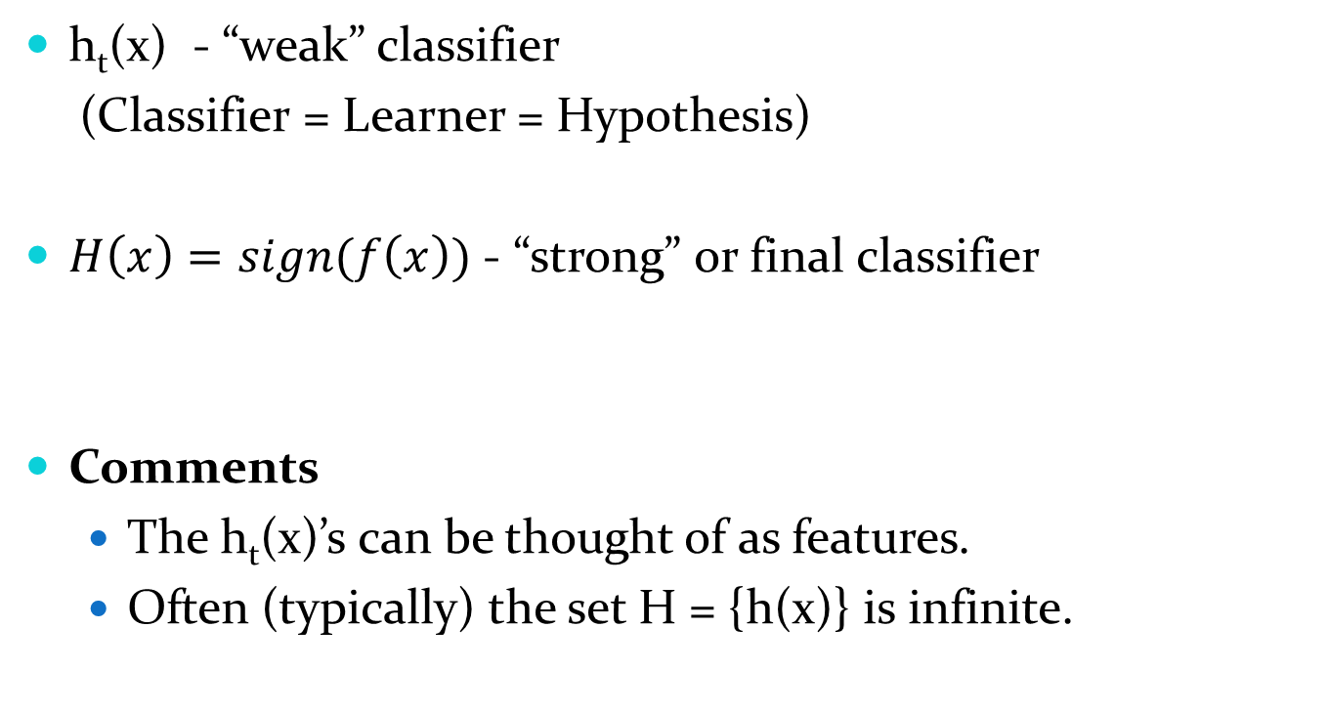
AdaBoost terminology
h_{t}(x) - “weak” classifier
(Classifier = Learner = Hypothesis)
$H\left(x\right)=sign(f\left(x\right))$ - “strong” or final classifier
Comments
The h_{t}(x)’s can be thought of as features.
Often (typically) the set H = {h(x)} is infinite.

Slide 7
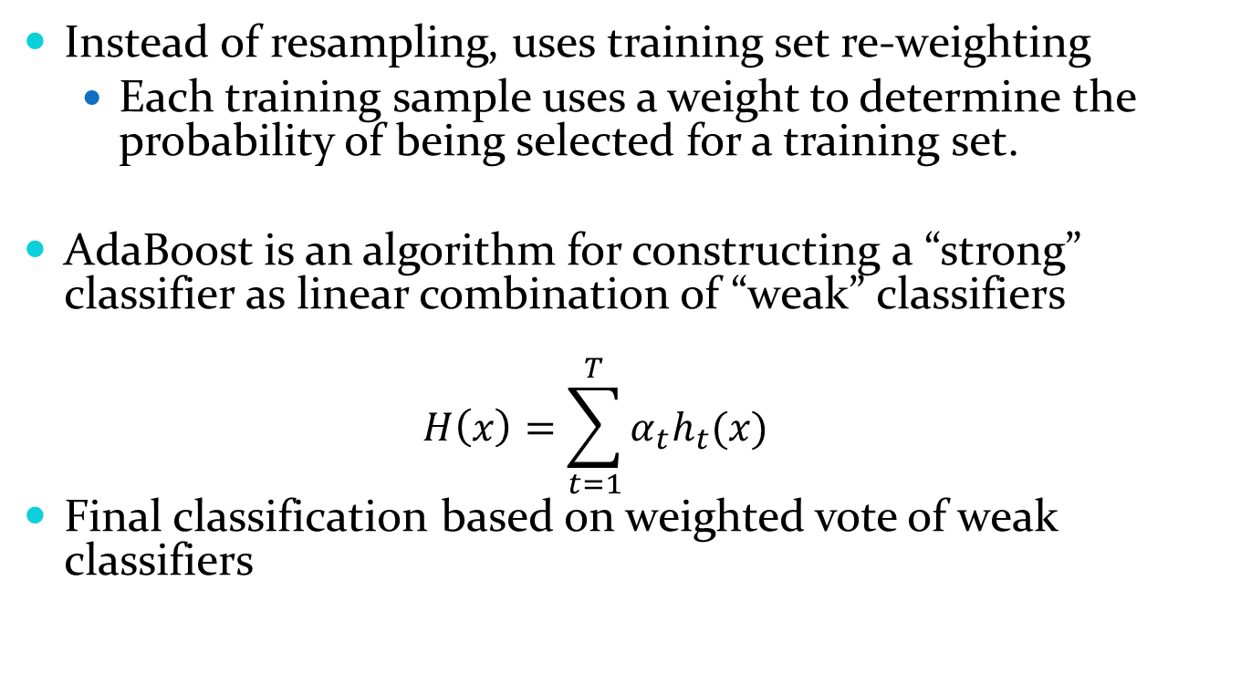
AdaBoost
Instead of resampling, uses training set re-weighting
Each training sample uses a weight to determine the probability of being selected for a training set.
AdaBoost is an algorithm for constructing a “strong” classifier as linear combination of “weak” classifiers
$$H\left(x\right)=\sum_{t=1}^{T}{α_{t}h_{t}(x)}$$
Final classification based on weighted vote of weak classifiers

Slide 8
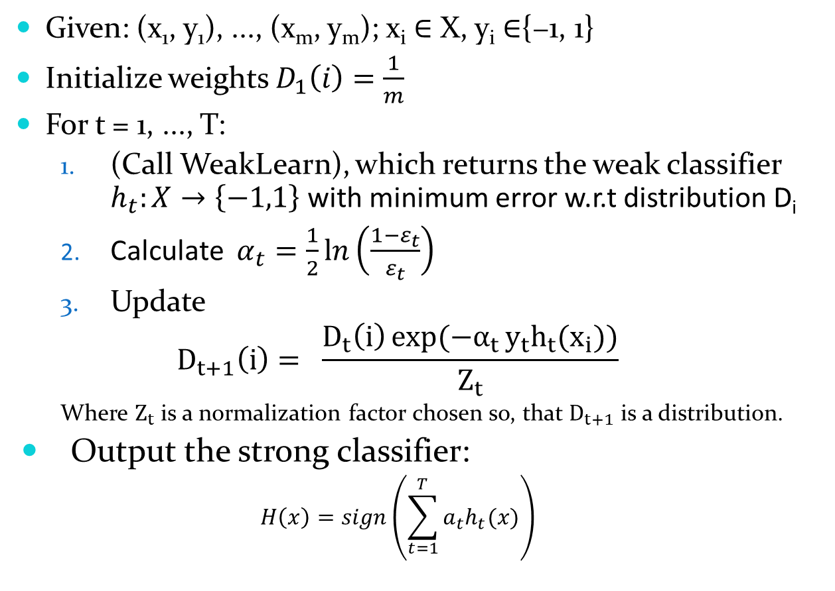
AdaBoost : The Algorithm
Given: (x₁, y₁), ..., (x_{m}, y_{m}); x_{i} $∈$ X, y_{i} $∈${−1, 1}
Initialize weights $D_{1}\left(i\right)=\frac{1}{m}$
For t = 1, ..., T:
(Call WeakLearn), which returns the weak classifier $h_{t}:X→\left\{−1,1\right\}$ with minimum error w.r.t distribution D_{i}
Calculate $α_{t}=\frac{1}{2}\ln\left(\frac{1−ε_{t}}{ε_{t}}\right)$
Update
$$D_{t+1}\left(i\right)= \frac{D_{t}\left(i\right)\exp{({−α}_{t}}y_{t}h_{t}(x_{i}))}{Z_{t}}$$
Where $Z_{t}$ is a normalization factor chosen so, that $D_{t+1}$ is a distribution.
Output the strong classifier:
$$H\left(x\right)=sign\left(\sum_{t=1}^{T}{a_{t}h_{t}(x)}\right)$$

Slide 9
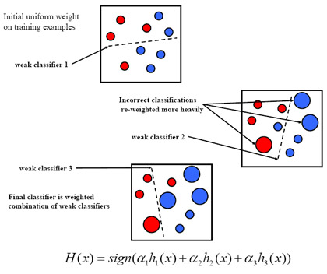
AdaBoost- Visual explanation

Slide 10
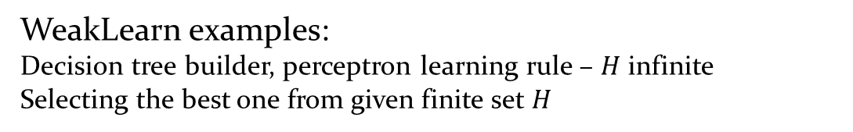
AdaBoost – Algorithm explanation 1
In the first approach we use as a “weak” classifier dichotomy in the noise parameter space.
x < threshold x >= threshold
WeakLearn examples: Decision tree builder, perceptron learning rule – $H$ infinite Selecting the best one from given finite set $H$

Slide 11
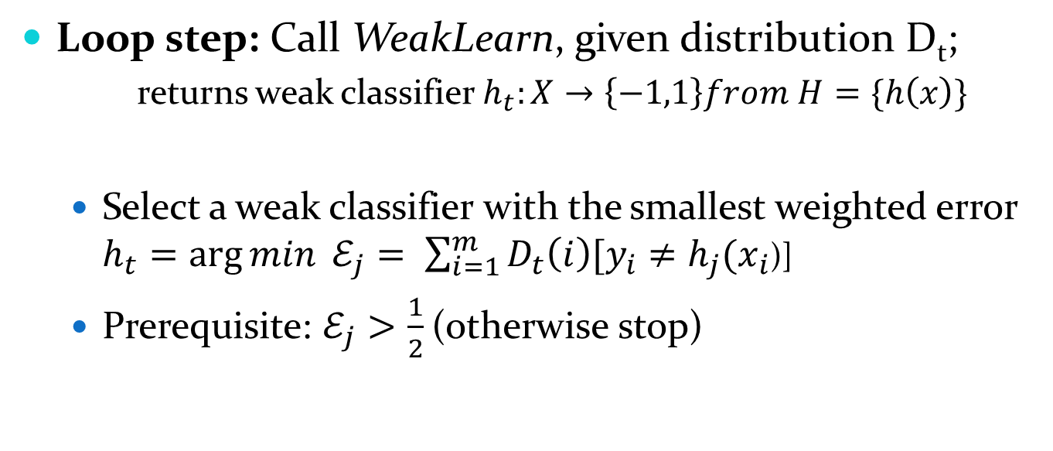
AdaBoost – Algorithm explanation 2
Loop step: Call WeakLearn, given distribution D_{t};
returns weak classifier $h_{t}:X→\left\{−1,1\right\}from H=\{h\left(x\right)\}$
Select a weak classifier with the smallest weighted error $h_{t}=\arg{min} ℰ_{j}= \sum_{i=1}^{m}{D_{t}\left(i\right)[y_{i}}≠h_{j}(x_{i}$)]
Prerequisite: $ℰ_{j}>\frac{1}{2}$ (otherwise stop)

Slide 12
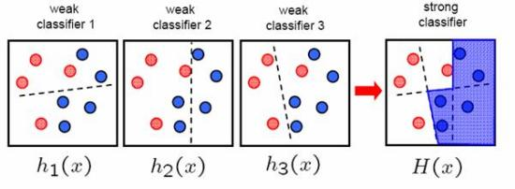
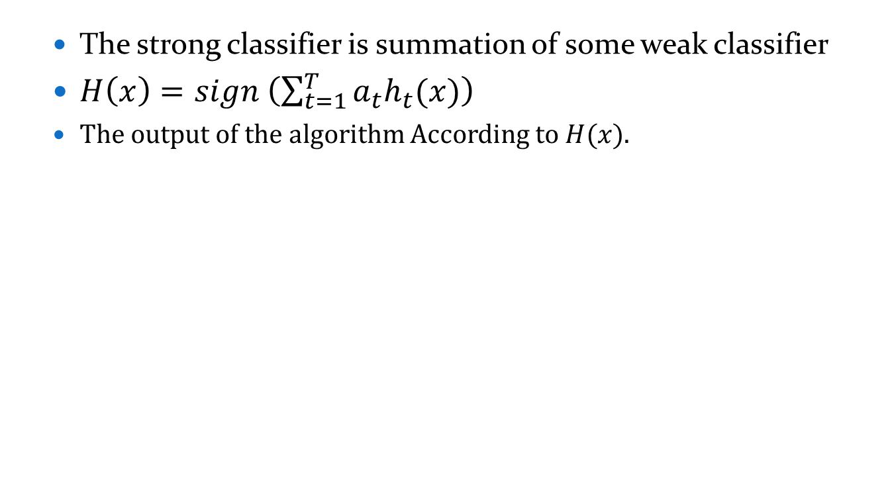
AdaBoost – Algorithm explanation 3
The strong classifier is summation of some weak classifier
$H\left(x\right)=sign \left(\sum_{t=1}^{T}{a_{t}h_{t}(x)}\right)$
The output of the algorithm According to $H(x)$.

Slide 13
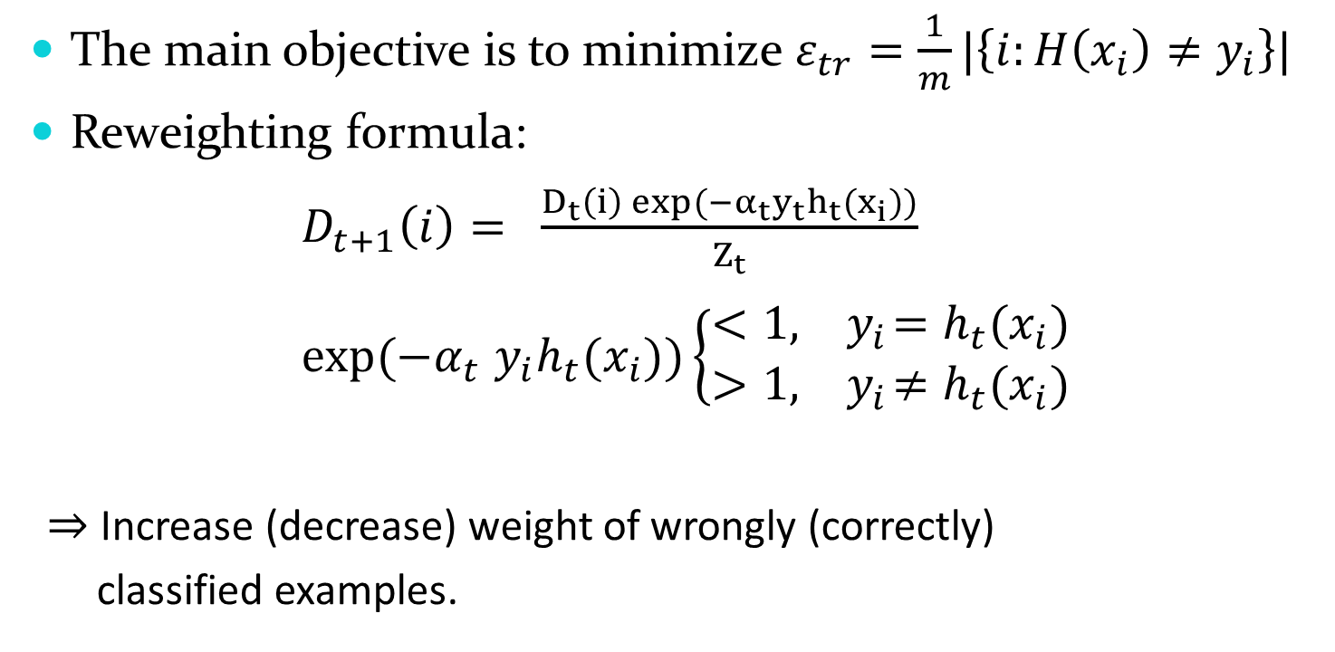
AdaBoost – Algorithm explanation 4
The main objective is to minimize $ε_{tr}=\frac{1}{m}|\left\{i:H\left(x_{i}\right)≠y_{i}\right\}|$
Reweighting formula:
$D_{t+1}\left(i\right)= \frac{D_{t}\left(i\right)\exp{({−α}_{t}}y_{t}h_{t}(x_{i}))}{Z_{t}}$
$exp⁡(−α_{t}$ $y_{i}h_{t}(x_{i}))\left\{\begin{aligned}<1,{ y}_{i}=h_{t}(x_{i}) \\ >1,{ y}_{i}≠h_{t}(x_{i})\end{aligned}\right.$
$⇒$ Increase (decrease) weight of wrongly (correctly)
classified examples.

Slide 14
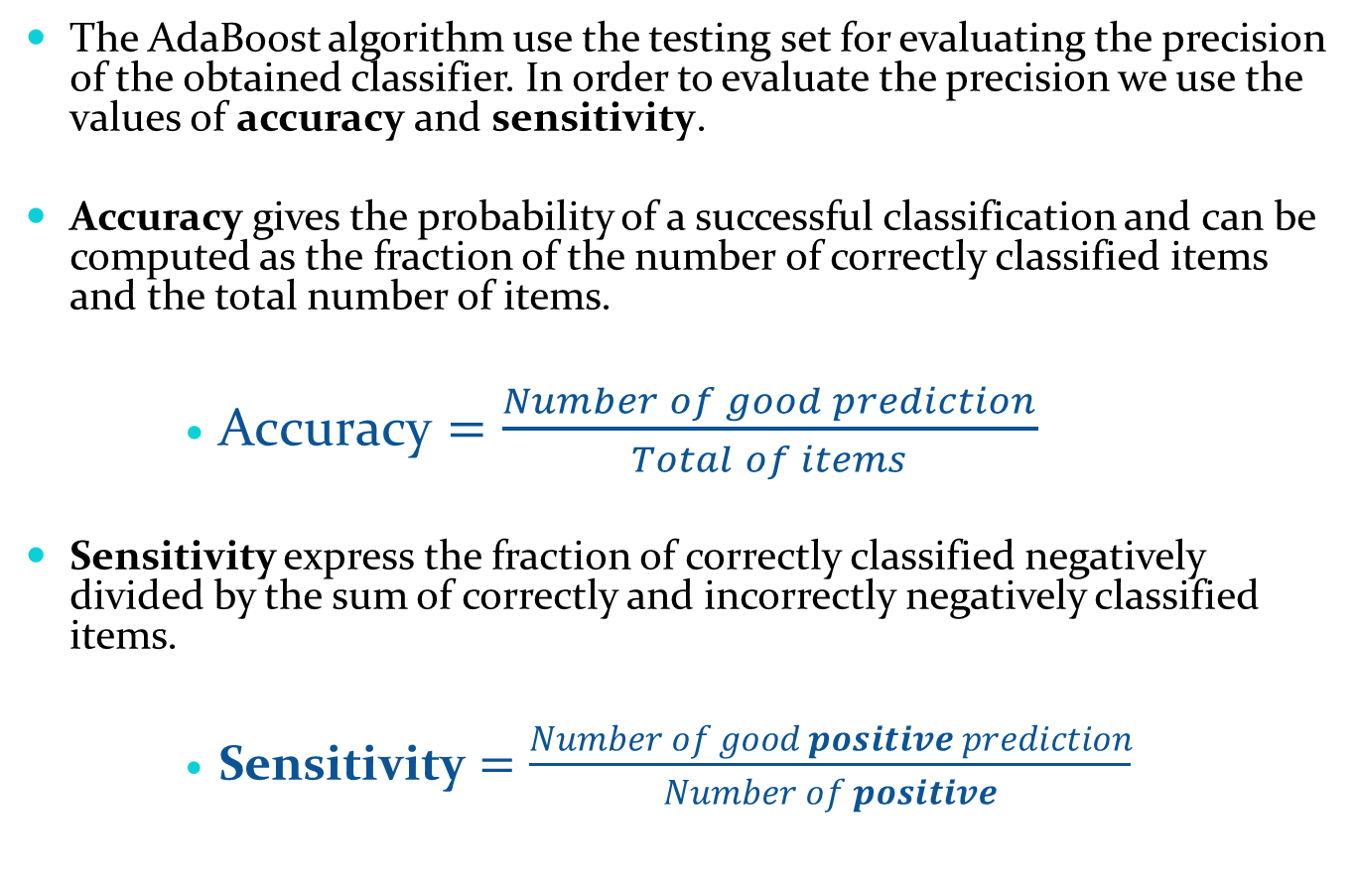
AdaBoost - measures
The AdaBoost algorithm use the testing set for evaluating the precision of the obtained classifier. In order to evaluate the precision we use the values of accuracy and sensitivity.
Accuracy gives the probability of a successful classification and can be computed as the fraction of the number of correctly classified items and the total number of items.
$\text{Accuracy}=\frac{Number of good prediction}{Total of items}$
Sensitivity express the fraction of correctly classified negatively divided by the sum of correctly and incorrectly negatively classified items.
$\text{Sensitivity}=\frac{Number of good positive prediction}{Number of positive}$

Slide 15
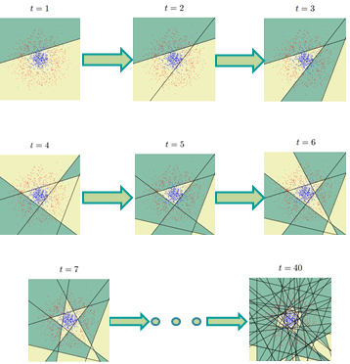
AdaBoost - visual explanation

Slide 16
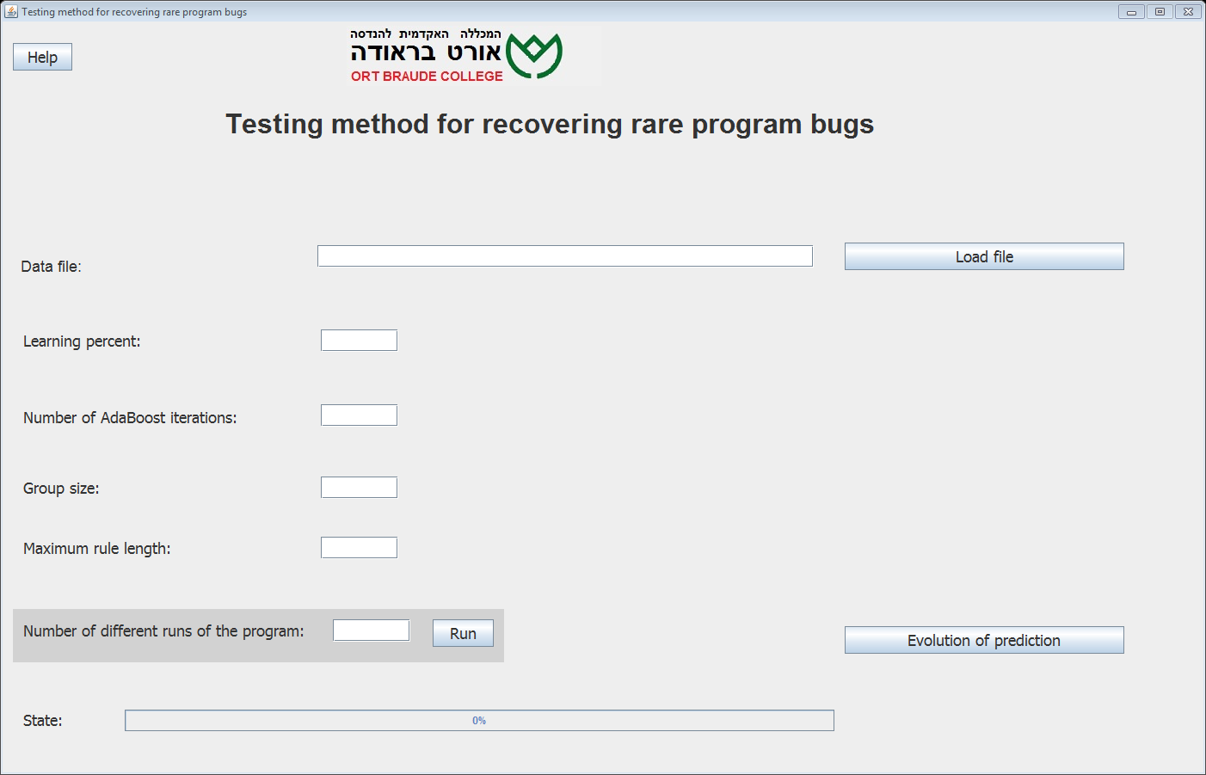
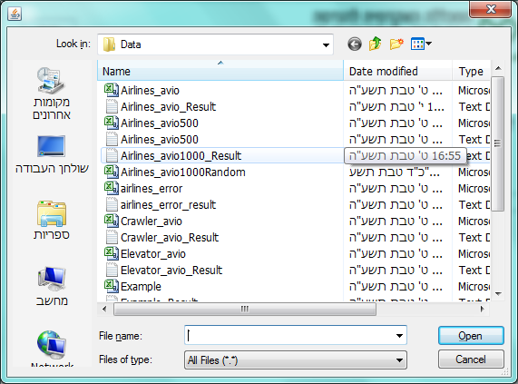
GUI - explain

Slide 17
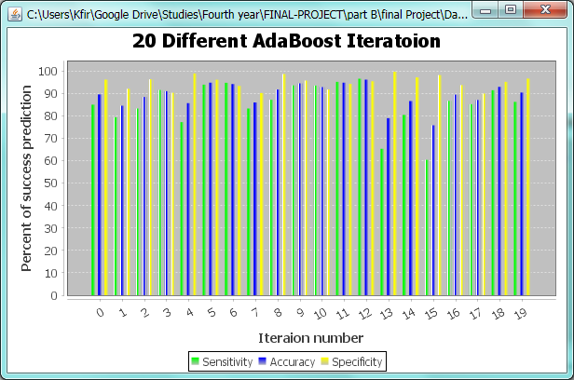
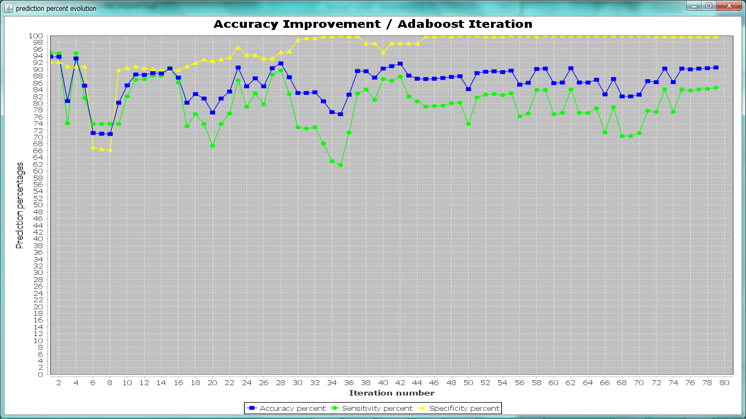
AdaBoost- example results

Slide 18
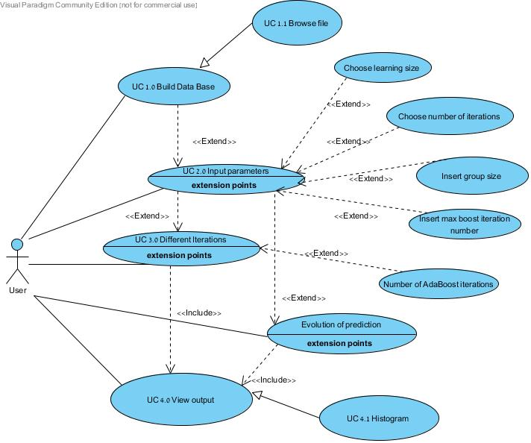
Use case diagram

Slide 19
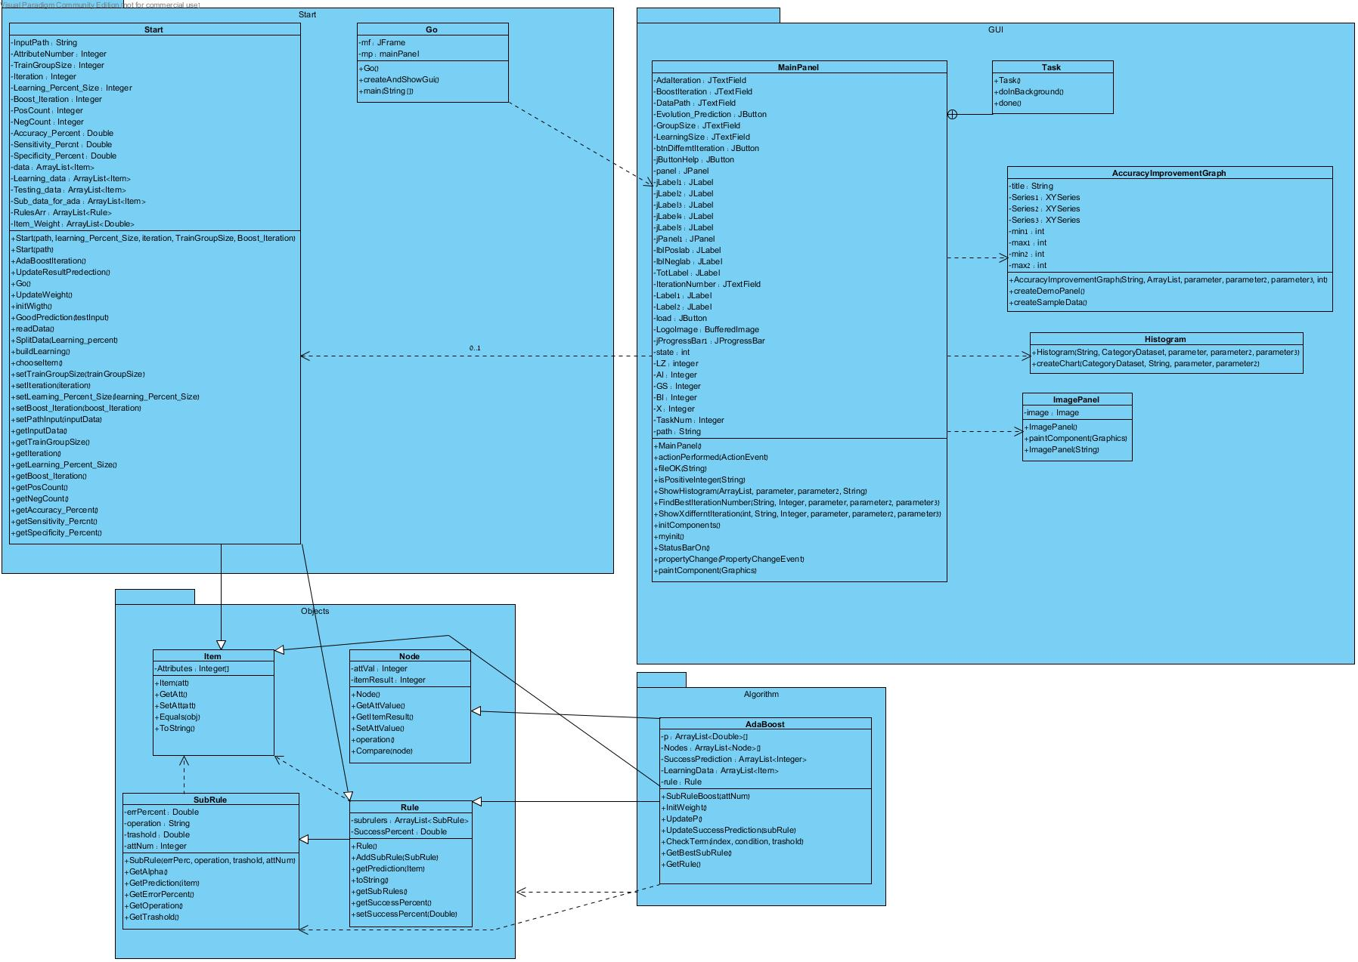
Class diagram

Slide 20
Class diagram- part 1

Slide 21
Class diagram- part 2

Slide 22
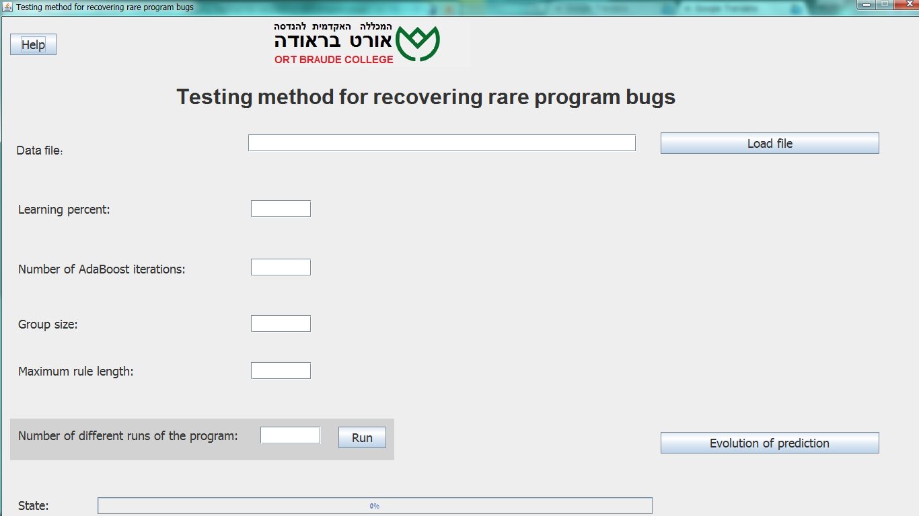
GUI

Slide 23
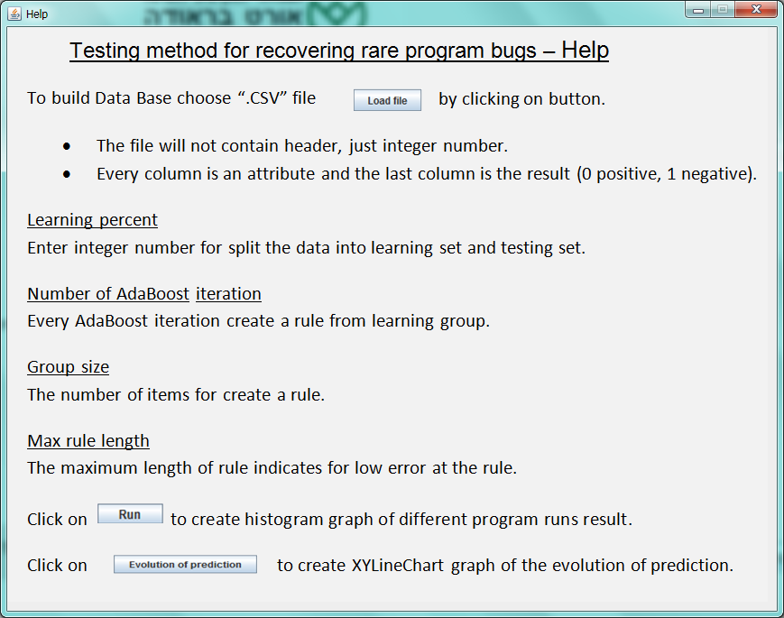
GUI
The ‘Help’ window

Slide 24
Testing
Test No. | Test subject | Expected result | Actual results
1. | Find rule when the database contains only one positive item. | The chosen rule will be equal to this positive item. | Pass
2. | Insert to database pairs items- one positive and one negative. | The accuracy will be low. | Pass
3. | Load database from chosen file. | The database will save as data base. | Pass
4. | Create one rule from database. | The rule will be bad and unsatisfactory rule. | Pass
5. | Change the specific data base to retrieve from. | Retrieve from the new data base. | Pass
6. | Run the program with learning percent = 1%. | The rule will be bad and unsatisfactory rule. | Pass
7. | Run the program with high number of AdaBoost iterations. | The accuracy will be high. | Pass
8. | Run the program with 20 different runs. | Get different, but similar, results. | Pass

Slide 25
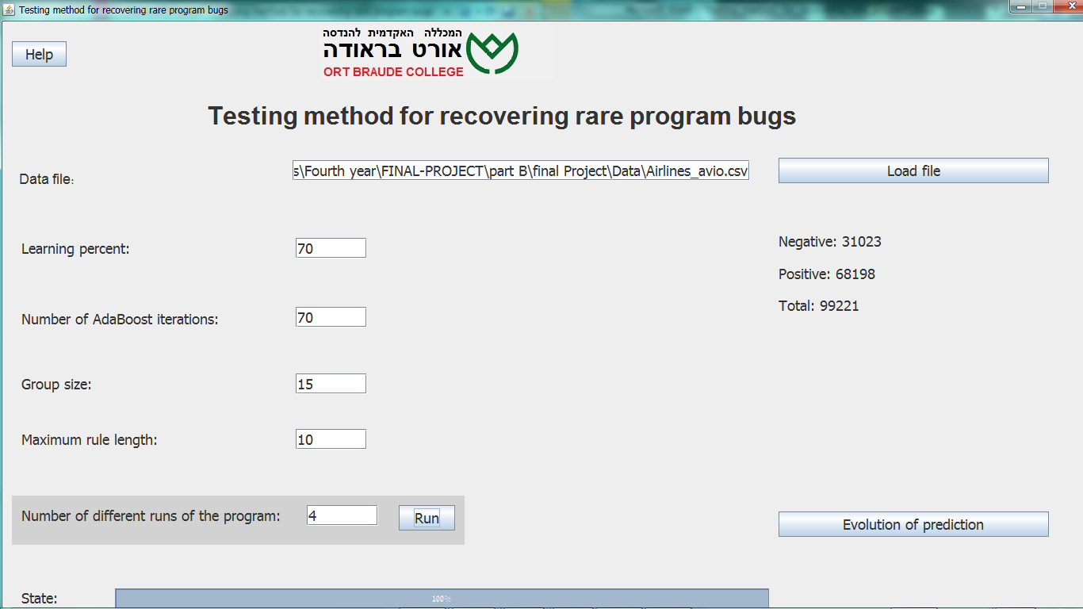
Results: Forecast testing results
The database: Airlines_avio

Slide 26
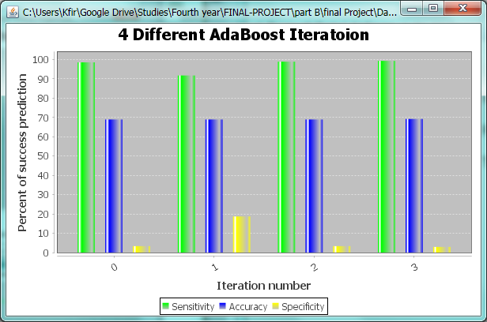
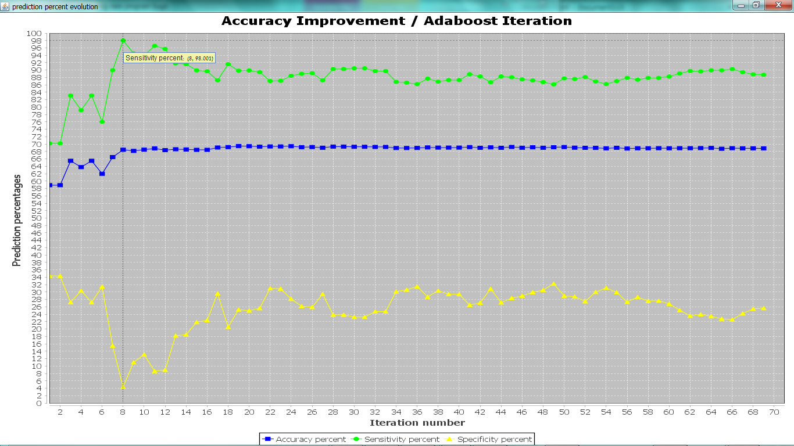
Results: Forecast testing results
We can see that after 8 iterations the improvement is minimal:
This database is not according to our system requirements!

Slide 27
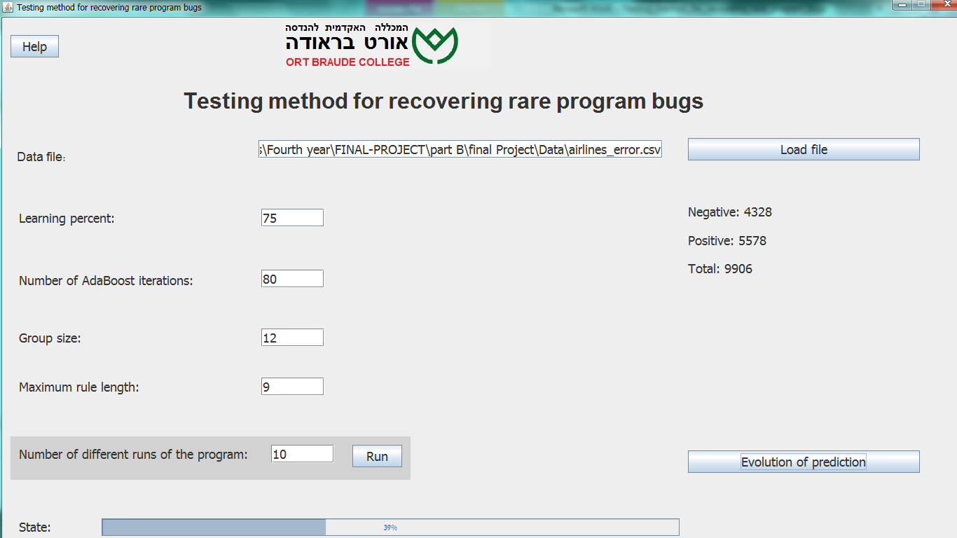
Results: Forecast testing results
The database: Airlines_error

Slide 28
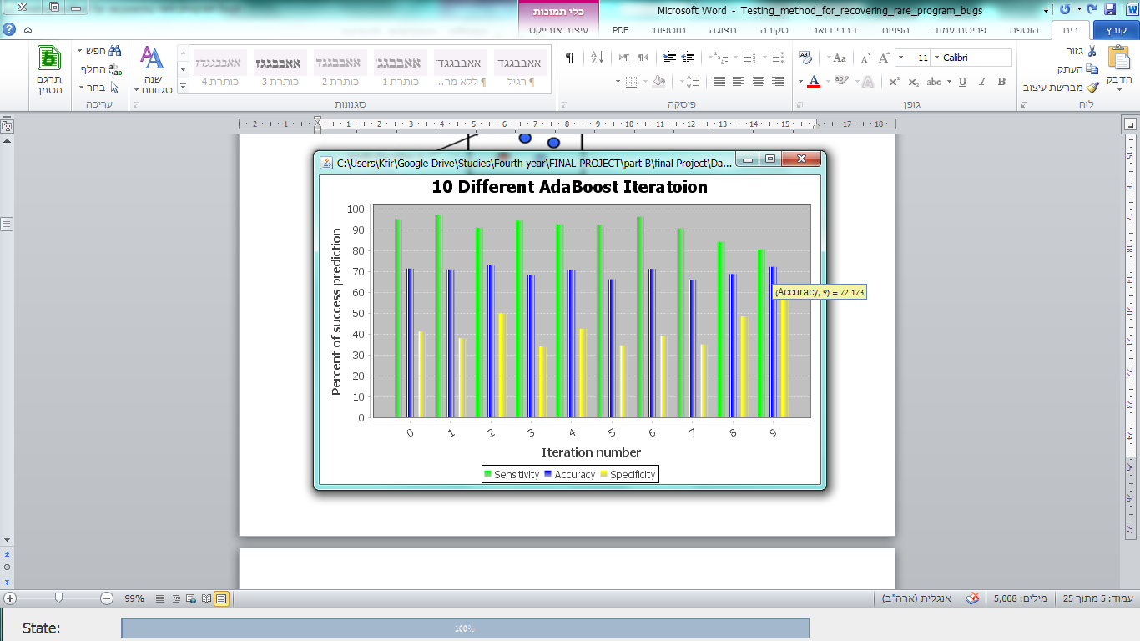
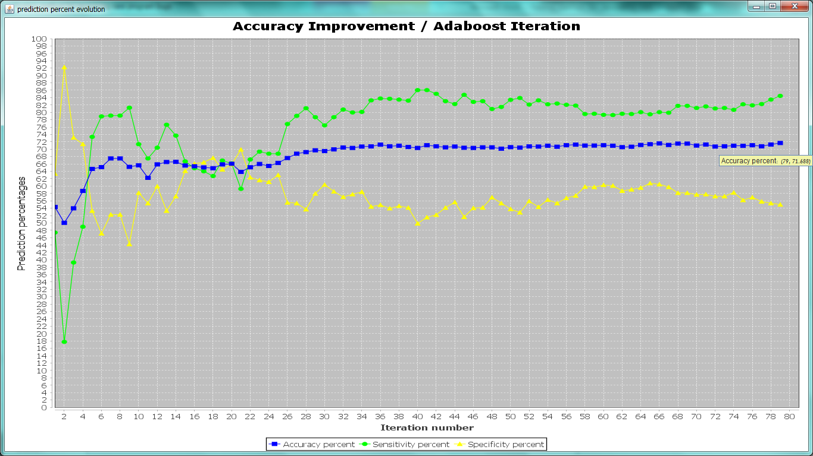
Results: Forecast testing results
The accuracy at the end is high: 72.173
The accuracy at the end is high: 71.688
This database is according to our system requirements!

Slide 29
Conclusions
The program concludes rules well and has high percent in an attempt to predict if item will succeed or fail.
There are false positive results.
The performance was relatively poor when:
The learning percent was low.
The database is not consistency with the system requirements.
The AdaBoost algorithm does accurately distributions, even better than other algorithms.

